Slide 1
CUSTOMER WEB PORTAL
Steve Monroe
VP, FMS Customer Initiatives, Information Technology
April 16, 2014
Proprietary and Confidential

Slide 2
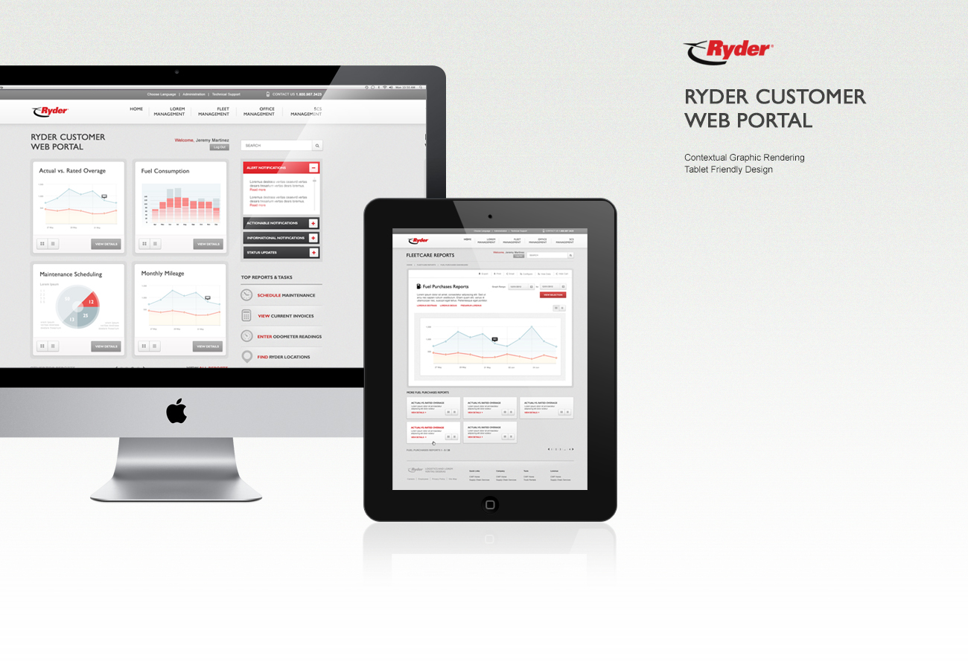

Slide 3


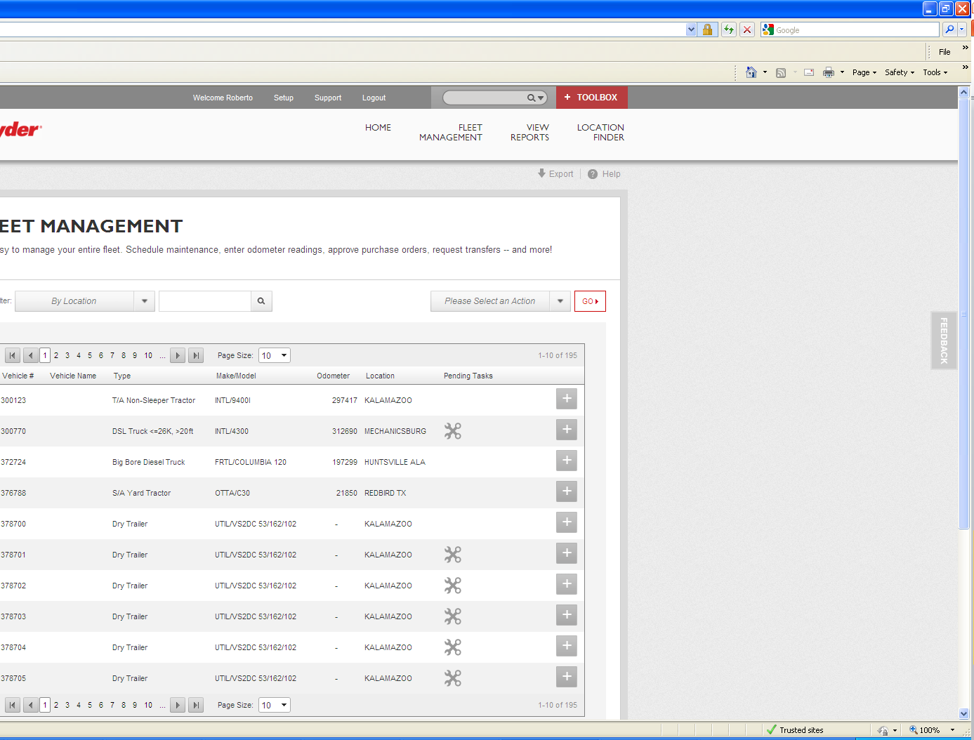
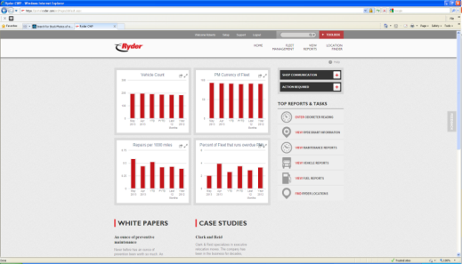
Fleet Management Portal
24/7 access to all fleet information
Features increase fleet management efficiencies via self-serve features:
Customized notifications
Roadside assistance cases (RCRC)
Odometer entry
Vehicle transfers
Schedule maintenance
Location finder
Reporting (integrated with FleetCare)
Mobile access to key functionality

Slide 4
Every vehicle counts
Stay updated and take action on the status of you fleet
Know exactly where is your vehicle in the maintenance process via notifications
View overdue PM vehicles and schedule and appointment
Add work requests to each vehicle for future repairs
Personalized your fleet by assigning names and organizational structure

Slide 5

Reporting and Dashboards
View, subscribe and customize fleet reports
Fleet performance and information
Services calls
Fuel activity
Vehicle repairs

Slide 6
Demo

Slide 7

Q&A

